Slide 1
Predicting Delta Flight Departure Delays from Hartsfield-Jackson Atlanta International Airport TEAM #6
Team Members
Pranthi Cavuturu
Muhammad Harris
Hussain Kaide Johar Manasi
April 17th, 2024
Notes:
Thao

Slide 2






Agenda:
Problem Statement and Objective
Data Pre-processing & Exploratory analysis
Algorithms, Analysis, and Implementations
Results and Evaluation
Conclusions
Group Member Contributions
Notes:
Charanya

Slide 3
Problem Statement and Objective

Slide 4

Problem Statement
The airline industry frequently encounters the issue of flight delays, which can lead to significant financial losses and decreased customer satisfaction. Delta Airlines, operating primarily from Hartsfield-Jackson Atlanta International Airport, faces challenges in predicting and managing these delays effectively. Accurate prediction of flight delays is crucial for optimizing operations, improving passenger experience, and enhancing overall efficiency.

Slide 5






Why this Problem Statement?
Competitive landscape within airline companies
Loss of revenue
Customer dissatisfaction
Financial Impact
Regulatory Compliance
Operational Efficiency
Strategic Planning

Slide 6
Objective
The objective of this project is to apply three predictive analytics methods—SARIMA, LSTM, and Prophet Model—to forecast flight delays for Delta Airlines flights departing from Atlanta Airport. By leveraging historical data on flight timings, airport traffic, and other relevant factors, the project aims to:
Use SARIMA's strength in analyzing delays influenced by seasonal travel trends and operational factors.
Employ LSTM networks to capture complex nonlinear dependencies and long-term historical contexts in the delay data.
Apply the Prophet Model to forecast flight delays by accommodating yearly, weekly, and daily seasonality, along with holiday effects.

Slide 7

Dataset and Assumptions ​
Approximately 429,000 records of flight departure data from the Bureau of Transportation Statistics ​
Delta Airlines flights from Hartsfield-Jackson Atlanta International Airport in 2022 and 2023​
Includes the date, flight details, scheduled and actual departure times, departure delay (in minutes), delay reasons​
Notes:
Thao

Slide 8
Data Preprocessing and Exploration

Slide 9
Data Preprocessing
Data did not have many missing values but used linear interpolation for two records with missing values
Converted Date with format (MM/DD/YYYY)’ to datetime and set as index and sorted by index
Extracted Temporal Features such as Day of week and Time of the day for LSTM training
Feature Scaling using MinMaxScaler()
Label Encoding for Categorical Features
Other preprocessing steps vary based on the models we are using (SARIMA, LSTM, and Facebook Prophet)

Slide 10
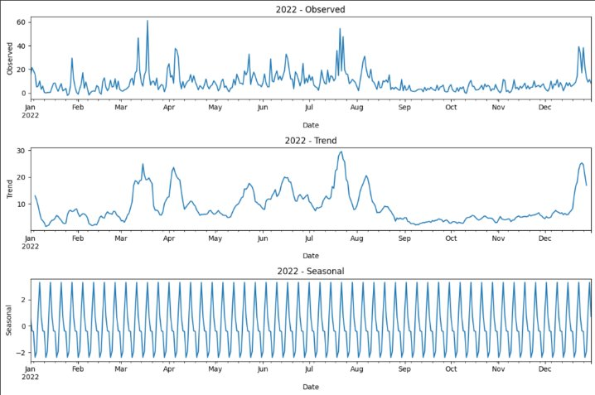
Exploratory Data Analysis​

Slide 11
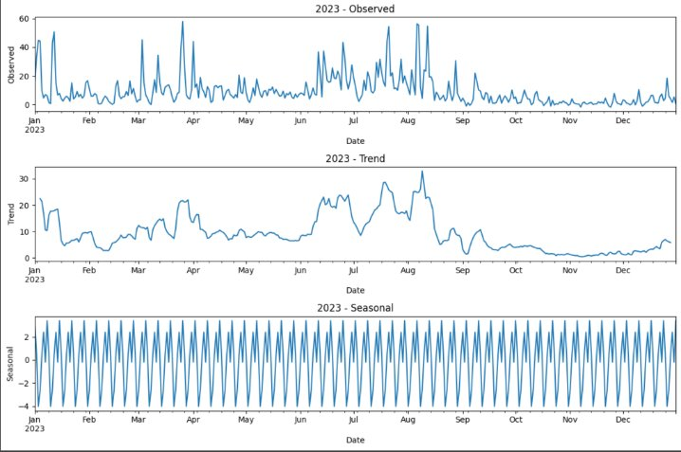
Exploratory Data Analysis​

Slide 12
Algorithms,
Analysis
&
Implementation

Slide 13
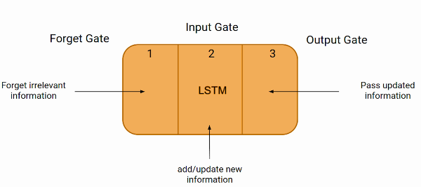
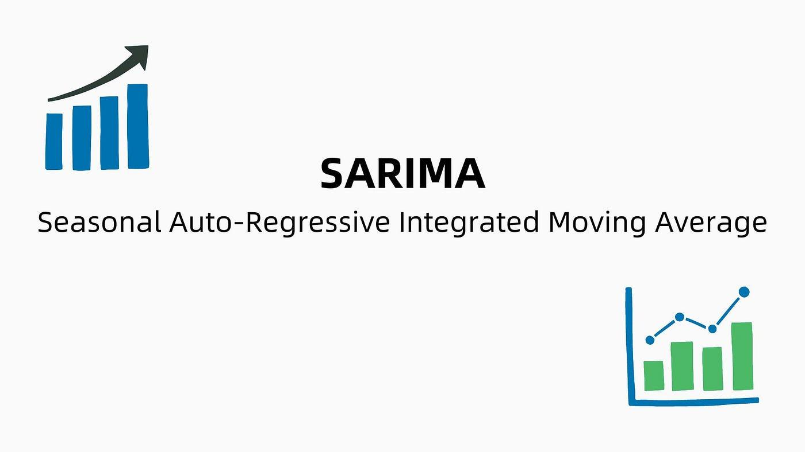

Our Approaches Overview​

Slide 14
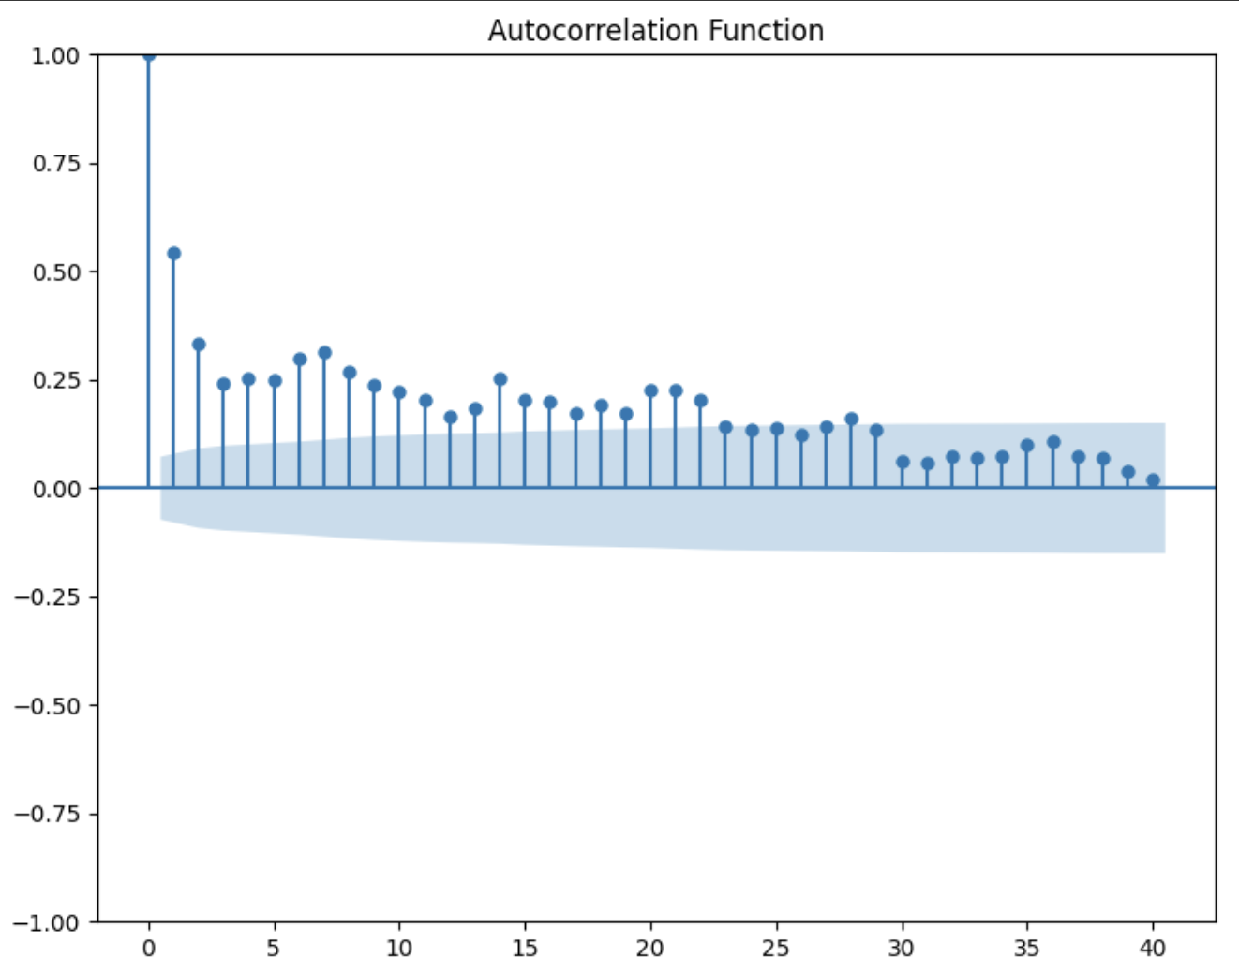
Approach 1: SARIMA
Good fit for a SARIMA model
Stationarity: ADF test results showed that the time series is likely stationary with a p-value of 0.002
ACF plot for daily lags for 40 days shows seasonality with spikes every 7 days
Used auto_arima function to find the best model
Notes:
Thao

Slide 15
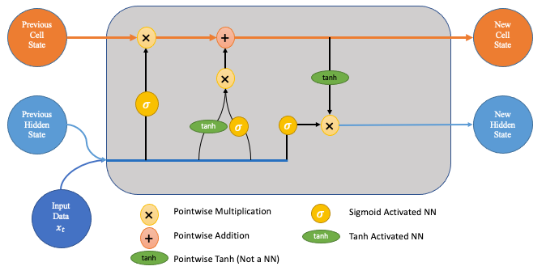
Approach 2: LSTM
Effective in overcoming the vanishing gradient problem common in traditional RNNs.
By incorporating temporal dynamics and external factors such as airport congestion and crew availability, LSTMs help forecast delays more accurately, enabling better resource management and contingency planning.
Notes:
Thao

Slide 16
LSTM Model Architecture
LSTM Layer 1
Dropout Layer
LSTM Layer 2
Dropout Layer
Dense Output layer
Captures temporal dependencies across the entire sequence, crucial for understanding context in sequence data.
128 units and Return Sequences (outputs a sequence to the next layer)
Drop out rate = 20%
Prevents overfitting by randomly setting 20% of the input units to zero during training, enhancing generalization.
Processes and condenses the information from the sequence into a single vector that summarizes the entire sequence.
Return Sequences: False (outputs the last time step's output only). 128 units
Further helps in preventing overfitting, ensuring robustness especially after more complex sequence processing. rate - 20%
Produces the final prediction from the processed data, translating the LSTM outputs into a tangible prediction.

Slide 17
Approach 3: Facebook Prophet Model
Prophet requires minimal data preprocessing. Columns were renamed to ‘ds’ and ‘y’ for compatibility with Prophet. ‘ds’ represents date/time column and ‘y’ is the metric to forecast.
Prophet is designed to automatically detect and model seasonal patterns
Model is well suited for datasets with daily observations
Tuning:
Explicitly defined holidays and set an upper and lower window (number of days before and after the holiday to consider) ​
Tuned the "changepoint_prior_scale" parameter : increasing the scale allows the model to be more sensitive to changes in trend
Notes:
Thao

Slide 18
Results and Evaluation

Slide 19
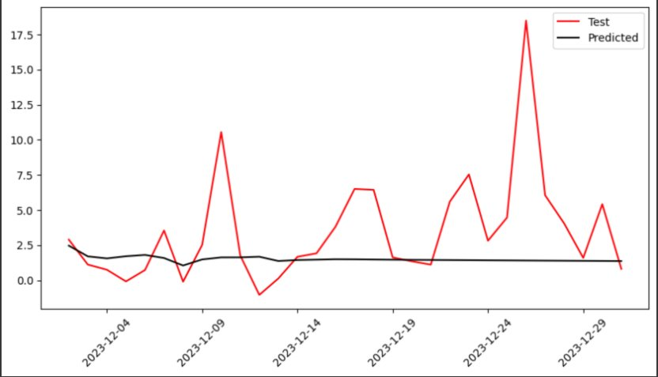
SARIMA Results and Evaluation​
​ | Mean Absolute Error​ | Root Mean Square Error​
Training Data​ | 4.96​ | 7.99​
Test Data​ | 2.64​ | 4.31​

Slide 20
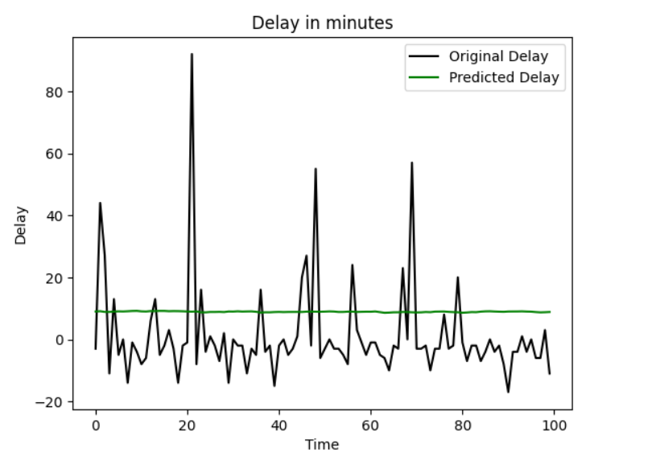
LSTM Results and Evaluation​
​ | Mean Absolute Error​ | Root Mean Square Error​
Training Data​ | 17.69 | 38.53
Test Data​ | 13.0 | 26.78

Slide 21
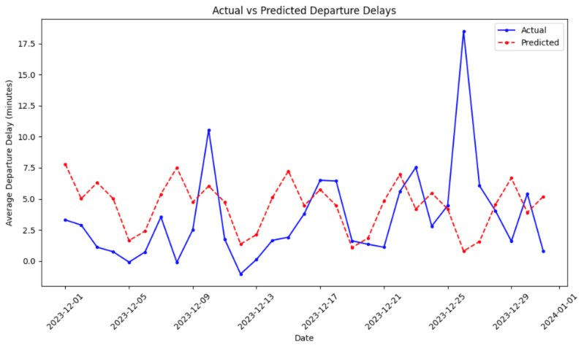
Facebook Prophet Model
Results and Evaluation​
​ | Mean Absolute Error​ | Root Mean Square Error​
Training Data​ | 6.18​ | 9.28​
Test Data​ | 3.26​ | 4.54​

Slide 22
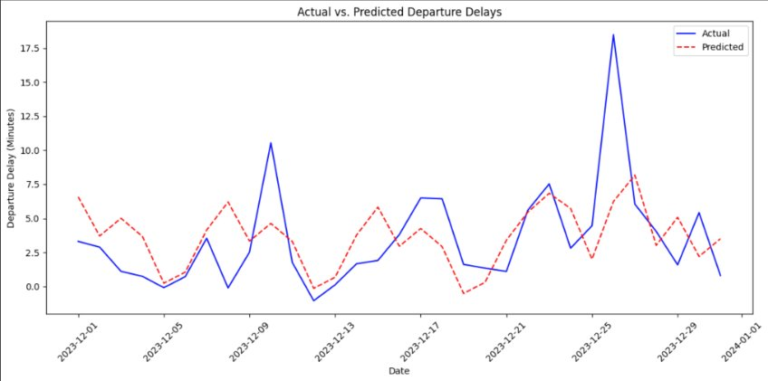
Facebook Prophet Model
Results after Tuning
​ | Mean Absolute Error​ | Root Mean Square Error​
Default Model Training Data​ | 6.18​ | 9.28​
Tuned Model Training Data​ | 6.05​ | 9.12​
Default Model Testing Data​ | 3.26​ | 4.54​
Tuned Model Testing Data​ | 2.49​ | 3.42​

Slide 23
Conclusions

Slide 24
Takeaways
Evaluation Metrics in Business Context
The tuned Prophet Model performs the best, with a minimal MAE of 2.49 and RMSE of 3.42.
The average daily delay for the entire dataset is 9.42 and we have MAE values of 2.49 (Facebook Prophet model).
In the airline industry, a lower MAE indicates that the model's predictions of flight delays are closer to the actual observed delays. This metric helps airlines assess the reliability of their delay predictions, which is crucial for operational planning, customer service, and communication.
RMSE is particularly useful in contexts where large errors are particularly undesirable. In the airline industry, this could relate to situations where predicting the delay time accurately is critical to avoid operational bottlenecks, excessive costs, or severe customer dissatisfaction.
Notes:
Thao

Slide 25


Expected Real World Impact
Deliver High Prediction Accuracy
Identify Patterns and Root Causes
Optimize Resources
Refine Customer Communication
Cost Reduction
Enhanced Customer Service
Strategic Advantages
Broader Application Scope

Slide 26
Group Member Contributions

Slide 27
Group Contributions
Pranthi Cavuturu | Facebook Prophet Model Exploratory Data Analysis Presentation and Report Evaluation Metrics Task Delegation
Muhammad Harris | LSTM Model Data Sourcing and Data Set Selection Presentation and Report Problem Statement formation
Hussain Kaide Johar Manasi | SARIMA Model Data Preprocessing Presentation and Report Real World Application

Slide 28
Thank you!

